Slide 1
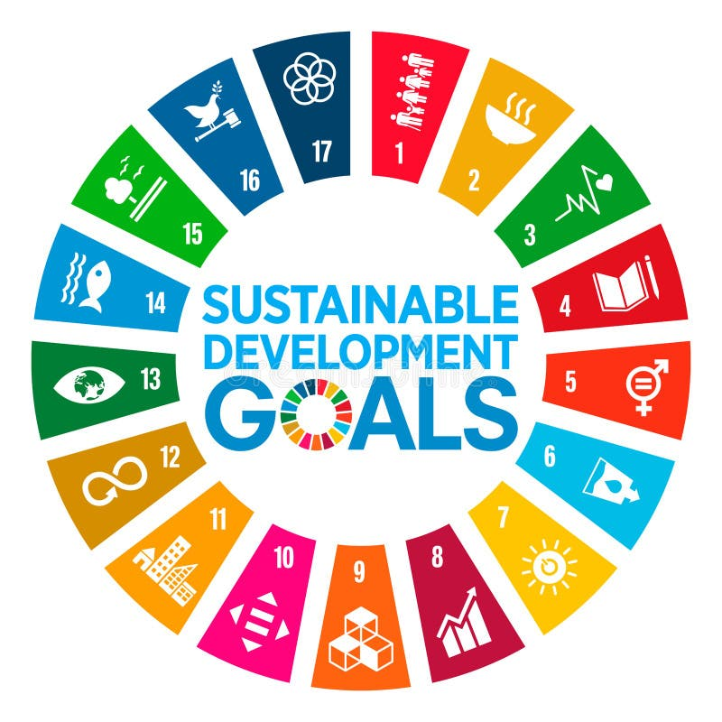
UNESCO ASPNET • TRINIDAD AND TOBAGO
Post-Sanya Conference
Implementation Report
Translating CIPP and ICUA ideas into local action across the educational pipeline
Deborah Hutchinson
UNESCO ASPnet National Coordinator, Trinidad and Tobago
Founder & Lead Facilitator, Innovation and Creativity through the Arts
June 2026

Slide 2

BACKGROUND
From Sanya to Trinidad and Tobago
Following Trinidad and Tobago's participation in the UNESCO ASPnet Global Conference in Sanya, China (March–April 2026), the national network committed to turning global ideas into local action.
Two frameworks guide this work:
CIPP (Collaborating to Improve and Protect our Planet) – a global online school partnership connecting students and educators around environmental action and the SDGs
ICUA – a complementary focus on inclusion and cultural awareness across the school community
Six initiatives now connect Sanya's ideas to 61 schools across 15 districts: Treasure Chest field trips, the Green Schools Urban Farming Pilot, the WSA Workshop Series, Inclusive Schools sensory spaces, the Coordinators network, and the SDG Lesson Plans Collection.
ASPnet Trinidad and Tobago • Post-Sanya Implementation Report
2

Slide 3
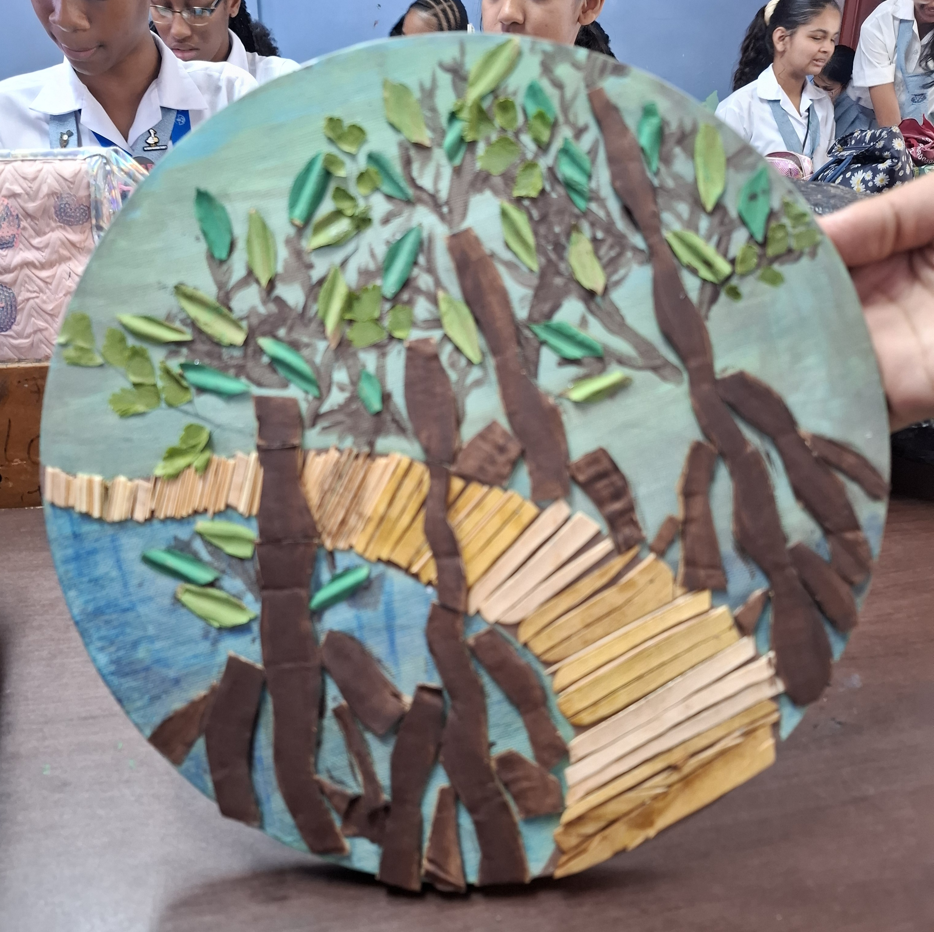

HERITAGE EDUCATION
Treasure Chest: A WSA Heritage Field Trip Programme
Treasure Chest, the network's heritage education ecosystem, is now a Whole School Approach field trip programme reaching the full educational pipeline — pre-primary, primary, and secondary.
Structured field trips to wetlands, mangroves, and coastal sites across Trinidad and Tobago
Cross-curricular links to Visual Arts, Geography, History, and Environmental Science
Field observations become mixed-media artworks for the SDG Lesson Plans Collection
Supports SDG 4, SDG 11 and SDG 15
Mangrove forest study made from natural materials gathered on a field trip
ASPnet Trinidad and Tobago • Post-Sanya Implementation Report
3

Slide 4
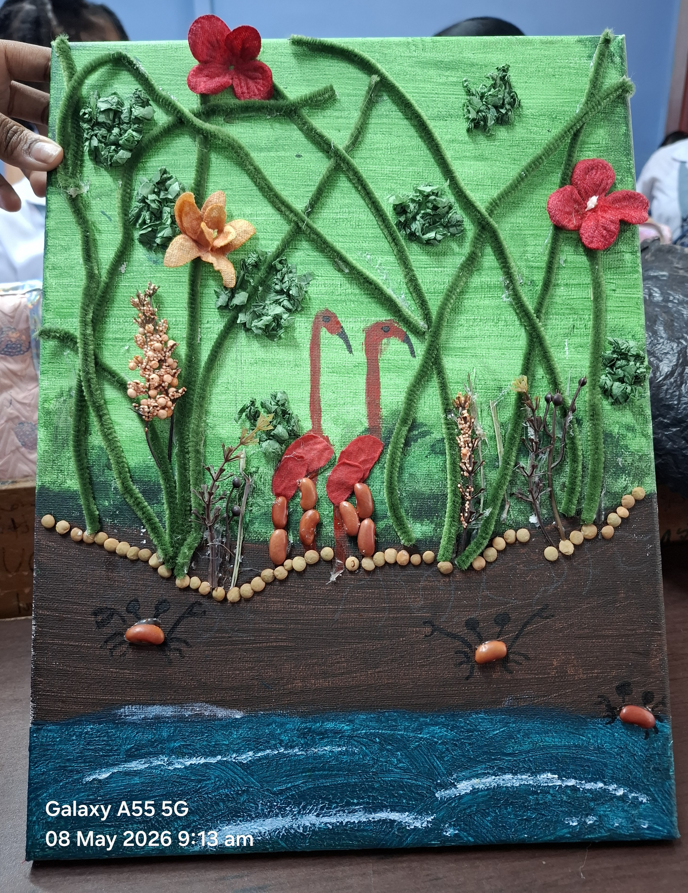

PARTICIPATION GRANT
Green Schools Urban Farming Pilot Project
Building on the UNESCO Participation Programme Green Schools proposal for SJCSF, the network has secured a grant to launch small-scale urban farming spaces in participating schools.
Hands-on growing, composting and sustainable food production
Living context for the environmental themes explored on Treasure Chest field trips
Produce and plant material feed directly into student artworks on local flora and pollinators
Supports SDG 2, SDG 12 and SDG 15
Wetland study with dried plants, seeds and beans
ASPnet Trinidad and Tobago • Post-Sanya Implementation Report
4

Slide 5





WHOLE SCHOOL APPROACH
10 Structural Workshops, 15 Schools, One Educational Pipeline
Workshops use the “School as a Body” model, mapping five connected domains so sustainability and inclusion are embedded across whole-school operations — not just single classrooms.
Head
Heart
Hands
Feet
Eyes
Leadership and Vision
School Culture: values, ethos, relationships
Teaching, Learning and Classroom Practice
Curriculum, Policy and Decision-Making
Monitoring, Evaluation, Well-Being and Voice
ASPnet Trinidad and Tobago • Post-Sanya Implementation Report
5

Slide 6
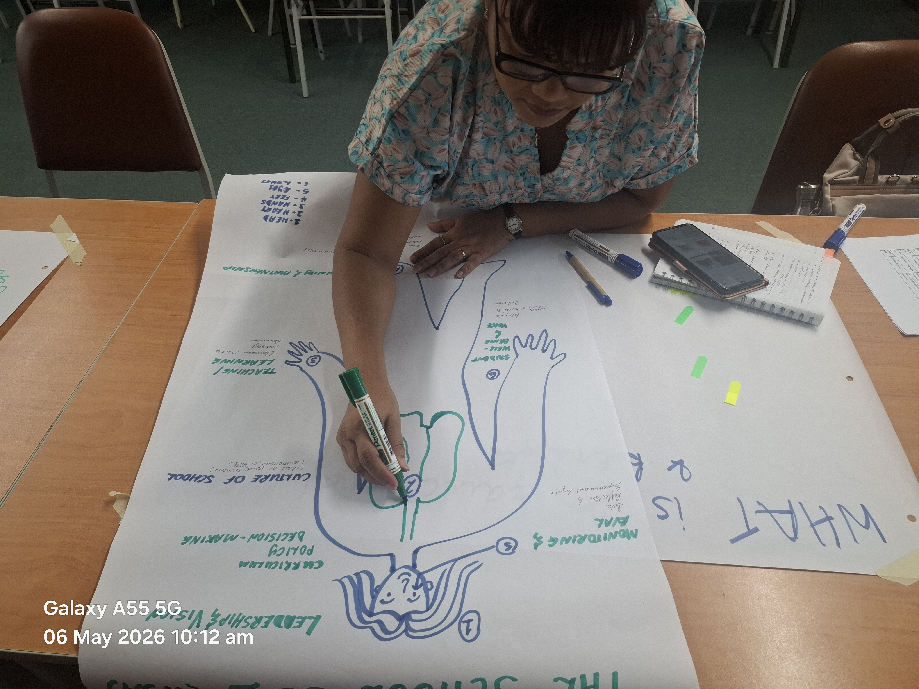
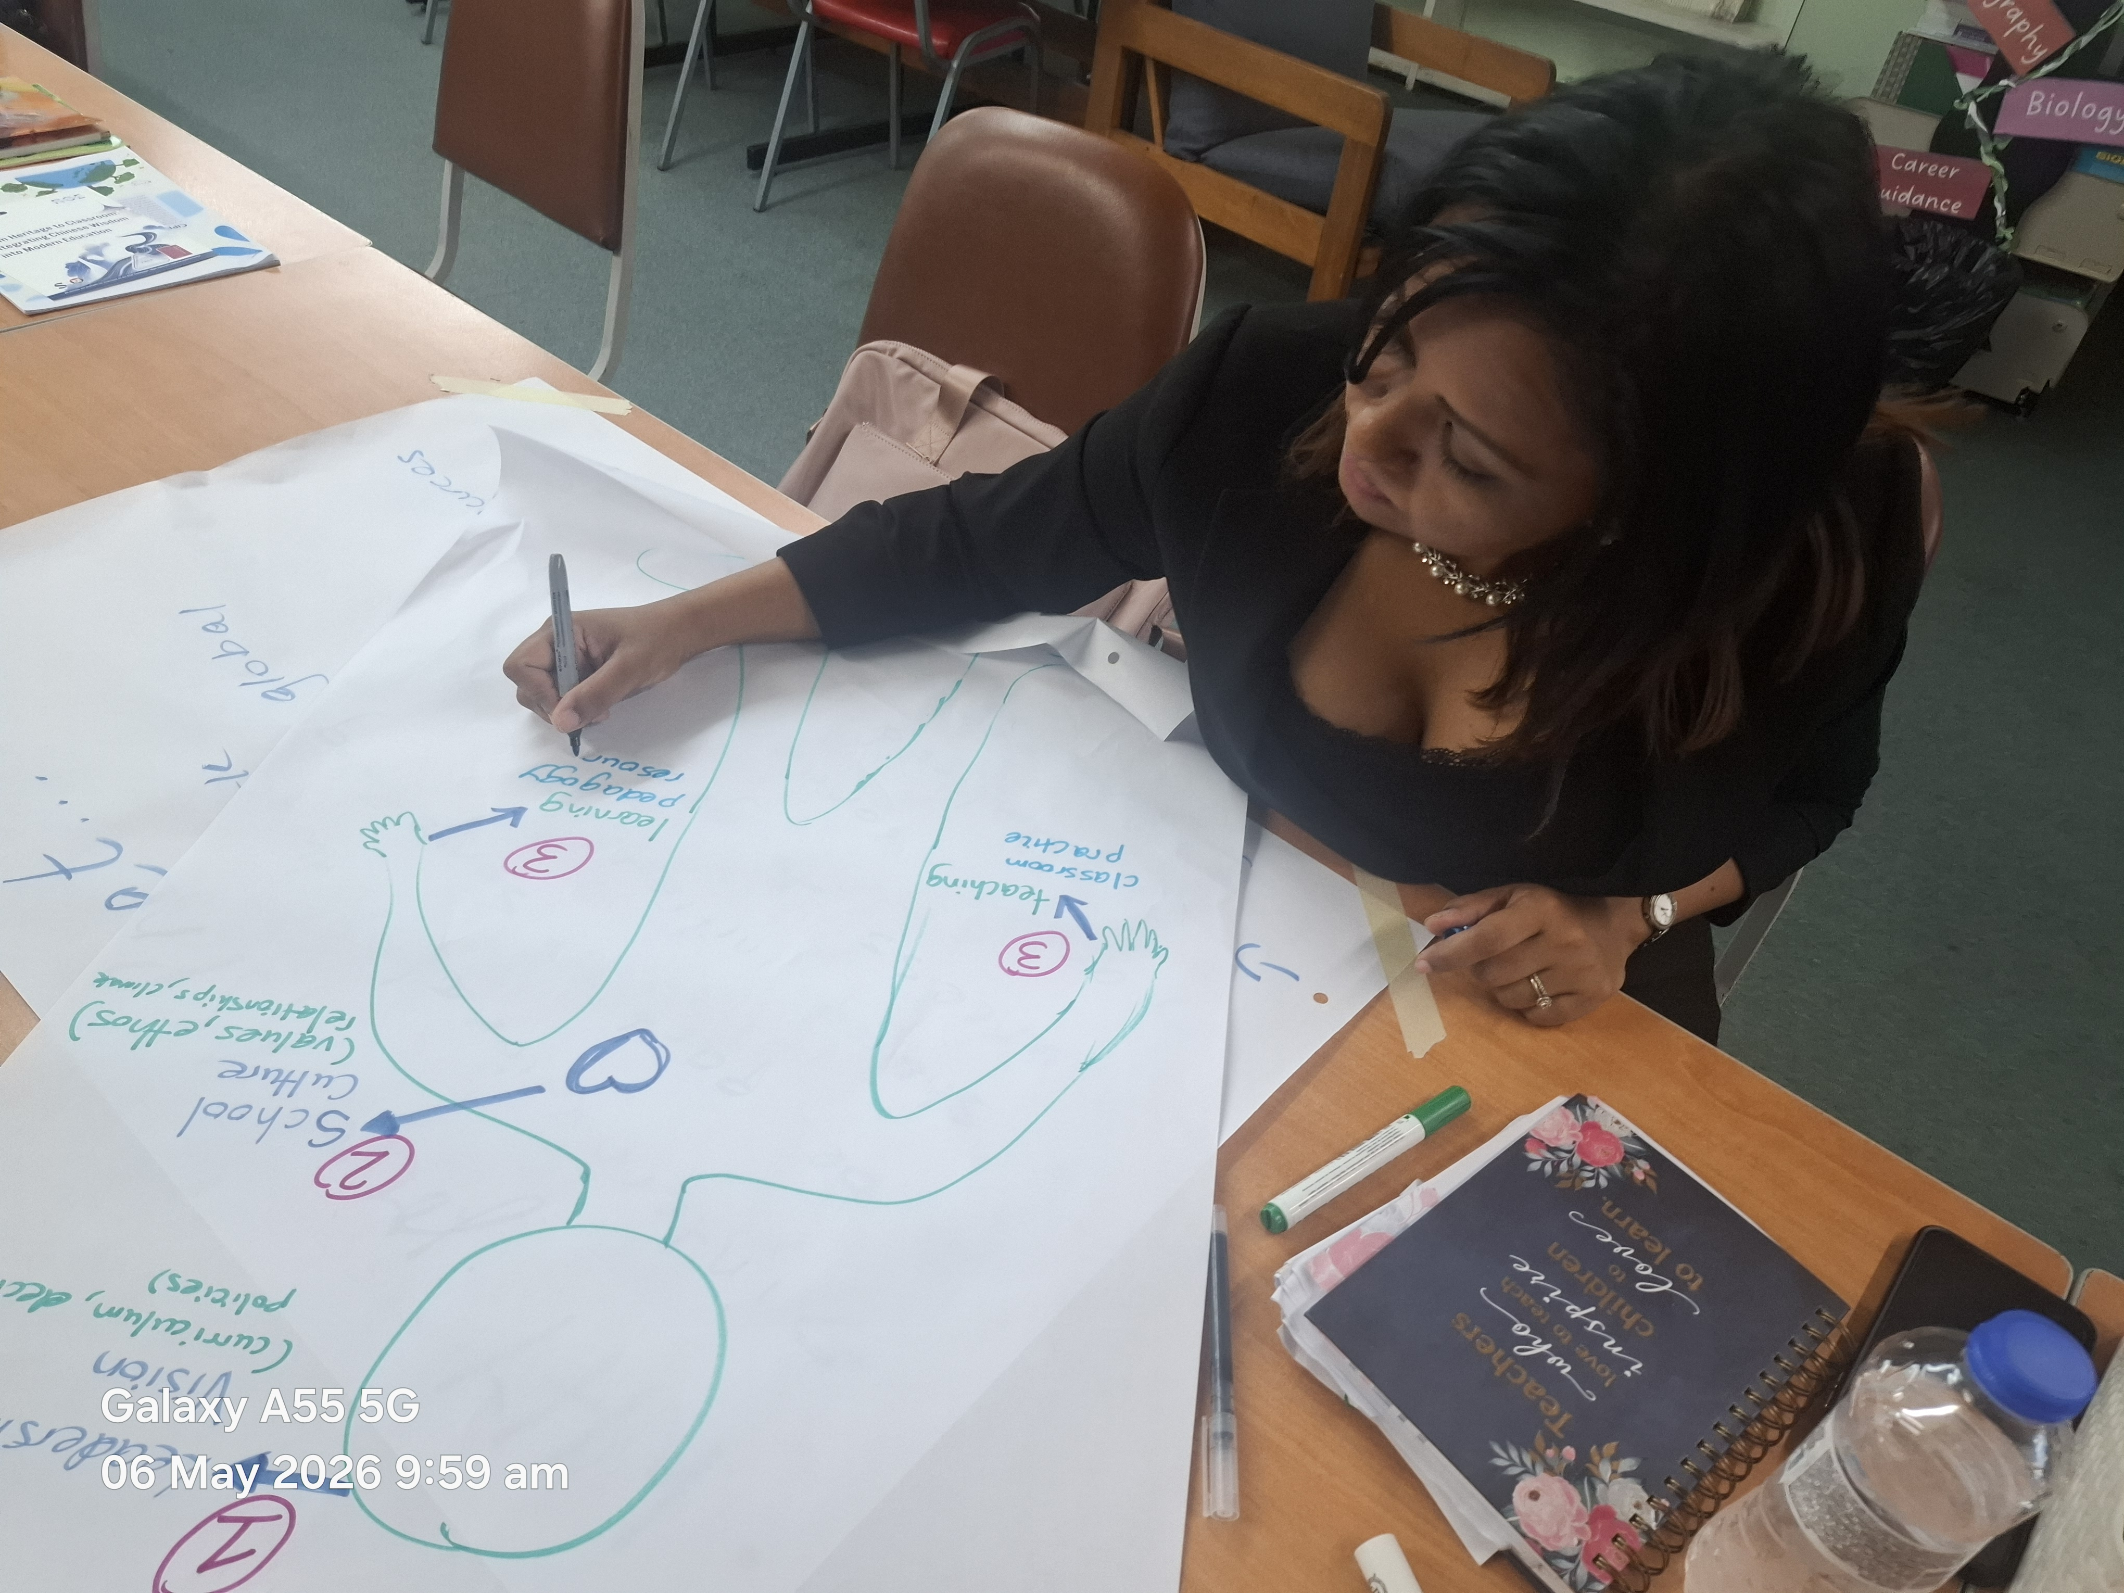
WHOLE SCHOOL APPROACH
Workshops in Action
Mapping the “School as a Body” model
Mapping School Culture: values, ethos and relationships
ASPnet Trinidad and Tobago • Post-Sanya Implementation Report
6

Slide 7
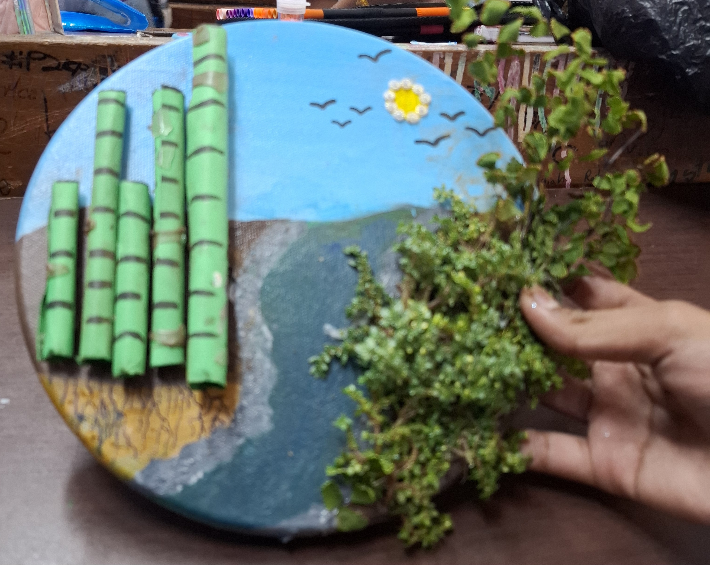

INCLUSION & WELLBEING
Inclusive Schools: Sensory Areas and Sensory Walks
ASPnet school libraries are establishing dedicated sensory areas — tactile, visual and natural materials in calming, supportive spaces.
Indoor sensory areas with textured surfaces, plants and calm colour palettes
Outdoor sensory walks: short nature trails of textures, scents, sounds and plant life
Builds awareness and acceptance of neurodiversity, echoing Funeriffic and Golden Years
A shareable implementation guide is in development for all 15 districts
Mixed natural-material artwork combining painted landscape and living plants
ASPnet Trinidad and Tobago • Post-Sanya Implementation Report
7

Slide 8
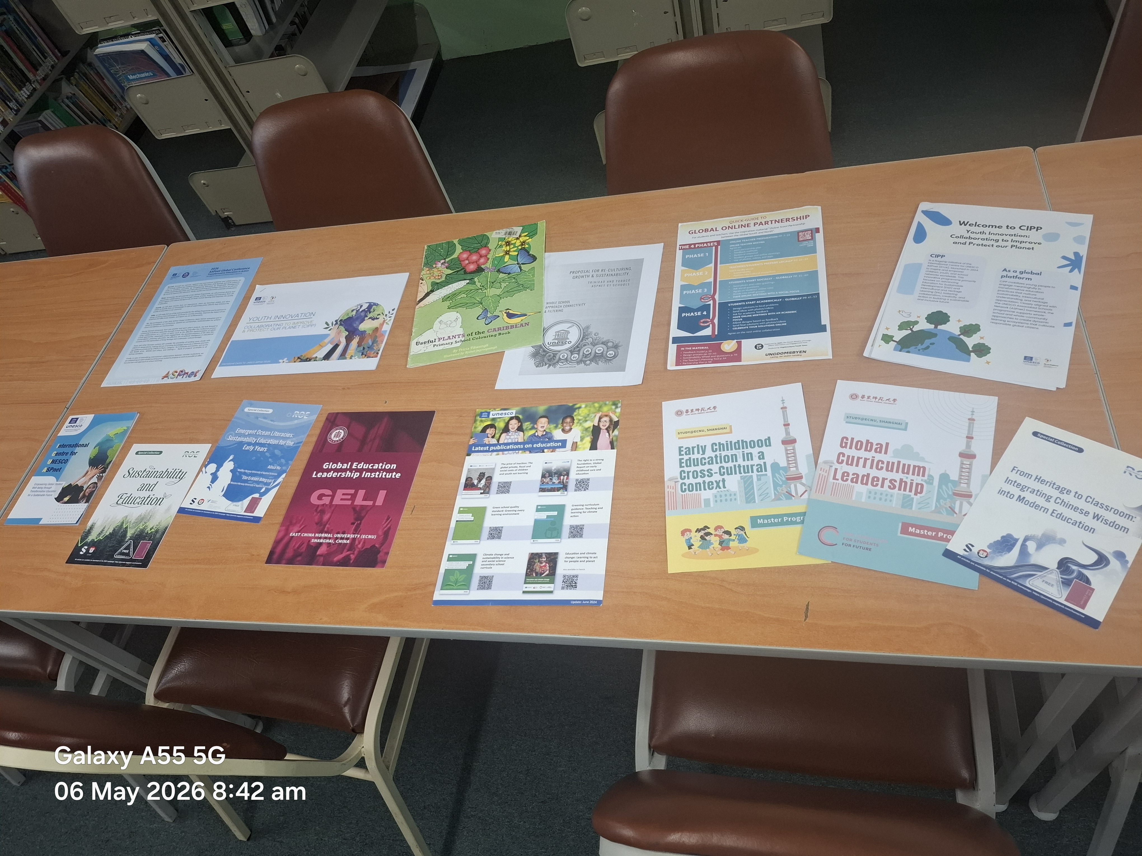

NETWORK & COMMUNICATION
Sanya ASPnet Coordinators Group
A dedicated WhatsApp group keeps the connections built at Sanya alive, giving coordinators a quick, informal channel to collaborate.
Share ideas, ask questions and post updates on local initiatives
Offer one another support adapting CIPP and ICUA to each national context
Already used to coordinate joint activities and share lesson plan ideas
Complements formal UNESCO ASPnet publications and resource-sharing
UNESCO ASPnet resources, including CIPP materials, on display at SJCSF
ASPnet Trinidad and Tobago • Post-Sanya Implementation Report
8

Slide 9
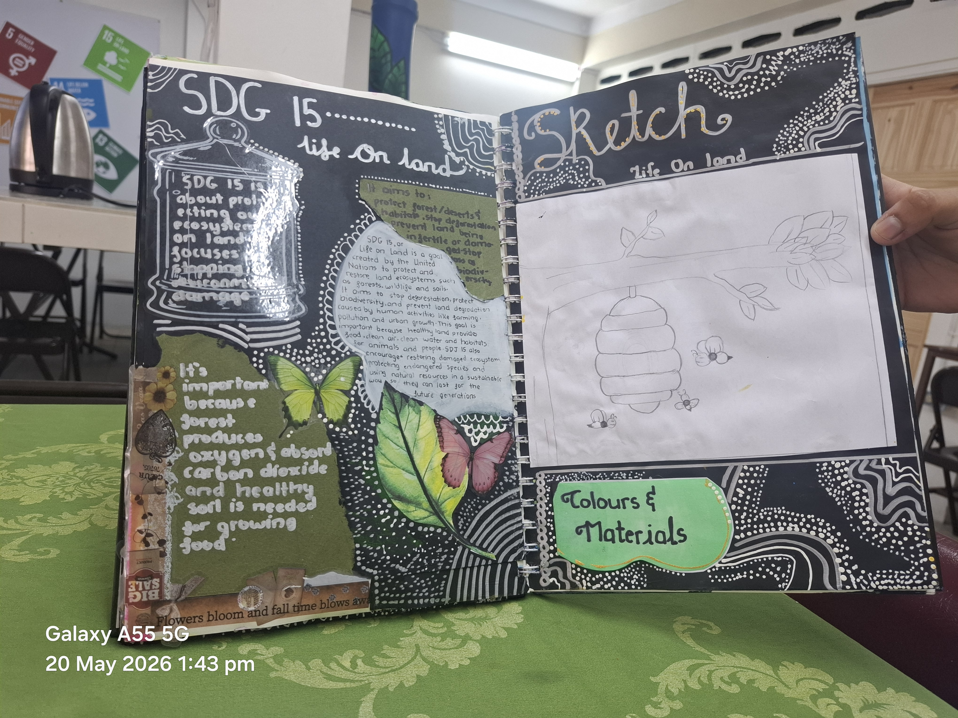
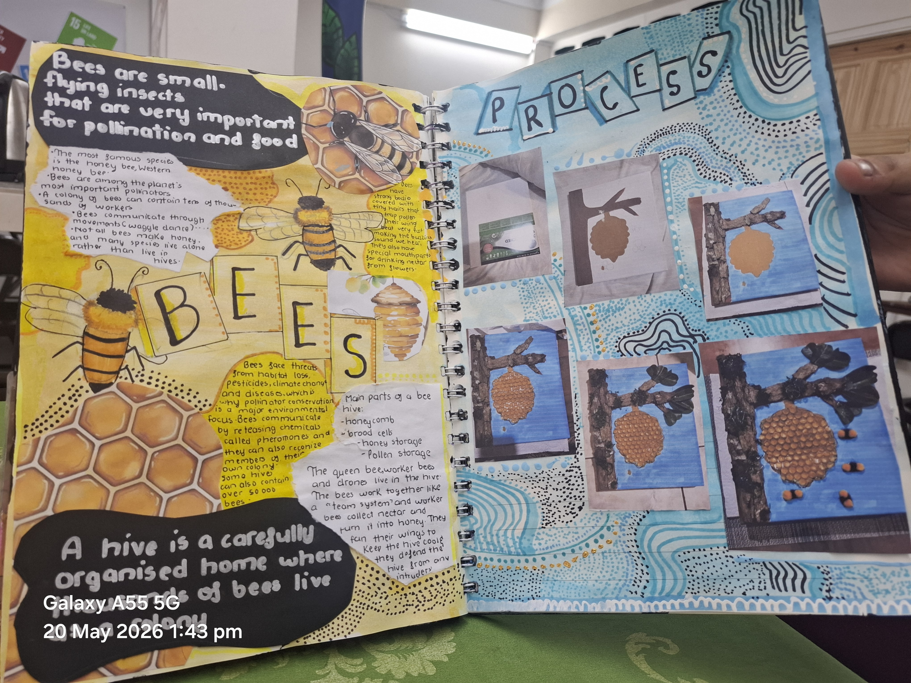
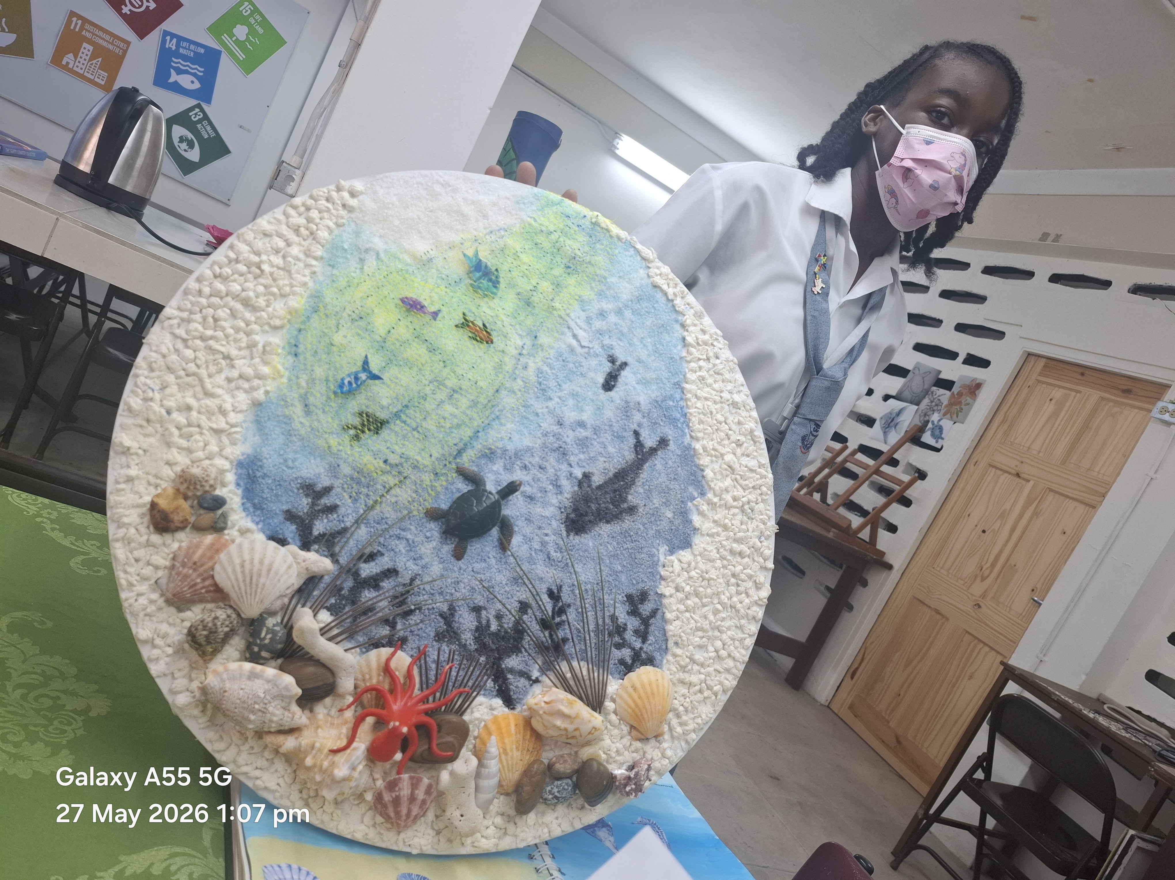
SHARED RESOURCE
SDG Lesson Plans Collection
Students across SJCSF and other ASPnet schools pair SDG research with original art journals — sketches, collage, and sculptural pieces made from natural and recycled materials.
These pages are being compiled into a shared book of classroom-tested, SDG-aligned lesson plans for ASPnet schools across Trinidad and Tobago and the wider Caribbean.
SDG 15: Life on Land journal spread
Bees and pollinators journal spread
Life Below Water mixed-media piece
ASPnet Trinidad and Tobago • Post-Sanya Implementation Report
9

Slide 10
LOOKING AHEAD
Conclusion and Next Steps
Complete the remaining structural workshops so all 15 schools have a documented WSA action plan
Publish a simple implementation guide for sensory areas and sensory walks across the 15 districts
Compile, edit and publish the first edition of the SDG Lesson Plans book
Use the Coordinators WhatsApp group to build a shared calendar of CIPP and ICUA activities
Monitor the Green Schools Urban Farming Pilot to inform wider rollout
Sanya to Trinidad and Tobago: one global gathering, sustained local impact — rooted in Caribbean culture, community and the arts.

