Slide 1



UNESCO
National Commission Trinidad & Tobago
2026-2028
SDG EDUCATION TOOLKIT

Slide 2
TABLE OF CONTENTS
01
Understanding SDGs in T&T Context
06
Community Engagement
02
The Whole School Approach
07
Corporate Partnerships (5 Mile Radius)
03
Curriculum Integration
08
Youth Leadership
04
Pedagogy for Sustainability
09
Monitoring & Evaluation
05
School Operations & Environment
10
Resources & Next Steps

Slide 3
01
UNDERSTANDING SDGs
Cymbal
Visual Identity Guidelines
Month 20XX

Slide 4


Slide 5

WHY SDGs MATTER FOR TRINIDAD & TOBAGO
OUR CHALLENGES
Economic diversification beyond oil & gas
Climate vulnerability (flooding, hurricanes)
Youth unemployment
Crime and violence
Environmental degradation
Social inequality

Slide 6
WHY SDGs MATTER FOR TRINIDAD & TOBAGO
OUR OPPORTUNITY
Vision 2030 alignment
Education as enabler
Building resilient future
Regional leadership

Slide 7
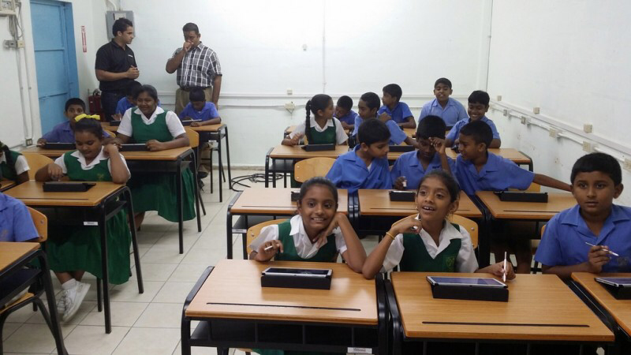
TRINIDAD & TOBAGO'S SDG PRIORITIES
HIGH PRIORITY
SDG 4: Quality Education
SDG 8: Decent Work & Economic Growth
SDG 13: Climate Action
SDG 16: Peace, Justice & Strong Institutions

Slide 8
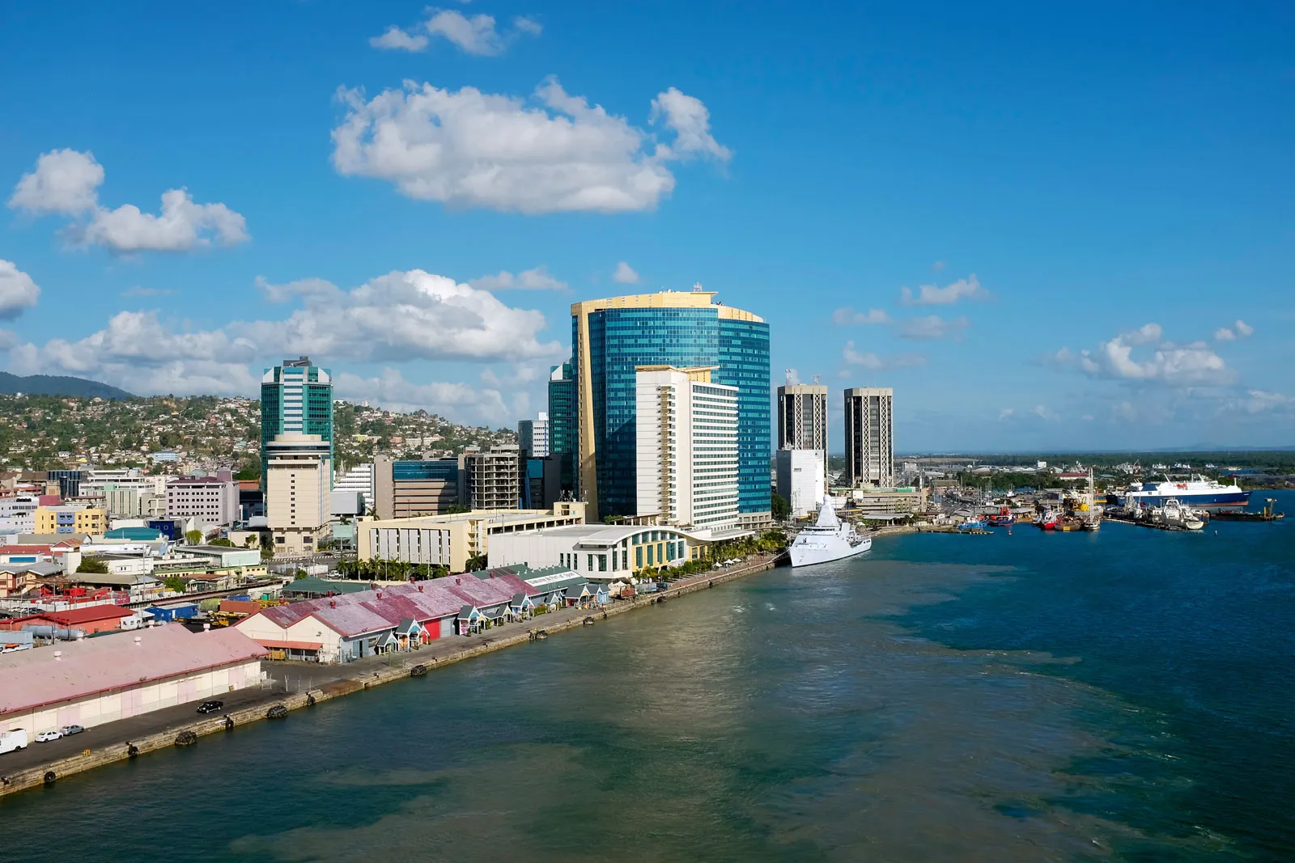
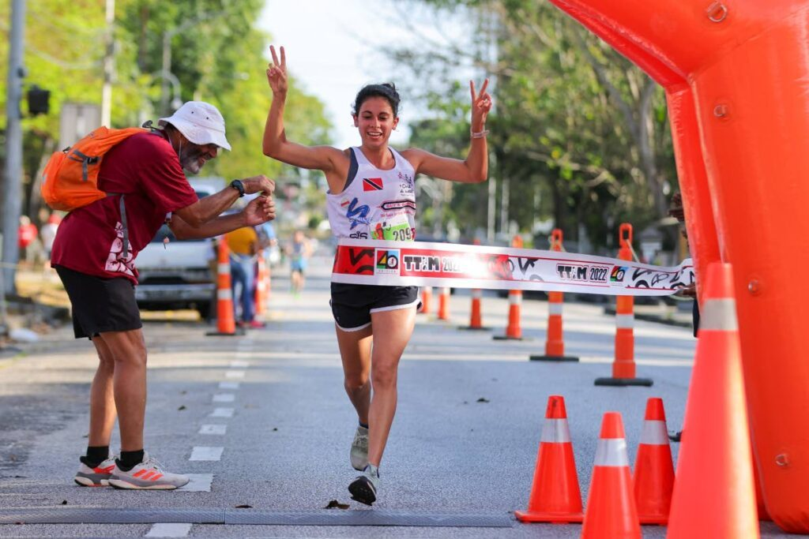
IMPORTANT
SDG 3: Good Health & Well-Being
SDG 5: Gender Equality
SDG 11: Sustainable Cities
SDG 14 & 15: Life Below Water & On Land

Slide 9
VISION 2030 & SDG ALIGNMENT
Vision 2030 Five Pillars:
1. People-Centred Development (SDGs 1,2,3,4,5,10)
2. Poverty Eradication (SDGs 1,2,10,11)
3. Economic Prosperity (SDGs 7,8,9,12)
4. Good Governance (SDGs 16,17)
5. Environmental Sustainability (SDGs 6,7,11,12,13,14,15)

Slide 10
02
THE WHOLE SCHOOL APPROACH

Slide 11

WHAT IS THE WHOLE SCHOOL APPROACH?
community relationships
governance
curriculum
environment
pedagogy
operations
culture

Slide 12
The entire school embodies and promotes SDG values
Not just:
- A subject or unit
- An add-on program
- Extra work for teachers
But rather:
- How we do everything
- Integrated across all aspects
- Sustainable transformation

Slide 13

THE SEVEN DIMENSIONS
Monitoring & Evaluation
Governance & Leadership
Vision, policies, resources
Assessment, improvement
Community Engagement
Curriculum & Learning
Partnerships, service-learning
SDG integration across subjects
Physical Environment & Operations
Teaching & Learning Approaches
School Culture & Ethos
ESD/GCED pedagogy
Sustainable practices
Values, relationships, democracy

Slide 14
GOVERNANCE & LEADERSHIP
Key Actions:
- School vision/mission includes SDGs
- SDG education in school development plan
- Policies aligned with SDG principles
- Student participation in governance
- Resources allocated for SDG initiatives
- Regular reporting on progress

Slide 15
DIMENSION 2 - CURRICULUM & LEARNING
Key Actions:
- SDGs integrated across all subjects
- Interdisciplinary learning opportunities
- Curriculum relevant to local context
- Learning outcomes include SDG competencies
- Assessment measures knowledge, skills, attitudes
- Regular curriculum review

Slide 16
TEACHING & LEARNING APPROACHES
Shift from:
- Teacher lectures → Student inquiry
- Memorization → Critical thinking
- Individual work → Collaboration
- Textbook learning → Real-world projects
- Passive → Active and engaged
Key Methods:
- Project-based learning
- Inquiry-based learning
- Place-based learning
- Service-learning
- Arts integration

Slide 17
SCHOOL CULTURE & ETHOS
Key Actions:
- School values reflect SDG principles
- Inclusive, respectful relationships
- Diversity celebrated
- Democratic participation normalized
- Environmental responsibility embedded
- Students feel empowered to make difference

Slide 18
PHYSICAL ENVIRONMENT & OPERATIONS
Key Actions:
- Environmental audits & sustainability plans
- Waste reduction, recycling, composting
- Energy & water conservation
- Sustainable procurement
- Green school grounds & gardens
- School operations model sustainability

Slide 19
MONITORING & EVALUATION
Key Actions:
- Regular self-assessment (twice yearly)
- Student learning outcomes measured
- Environmental indicators tracked
- Stakeholder feedback collected
- Progress documented and reported
- Learning informs continuous improvement

Slide 20
IMPLEMENTATION ROADMAP
1
2
3
4
Months 1-6
Months 6-12
Year 2
Year 3
Awareness, commitment, planning
Training, piloting, early implementation
Scaling, quality improvement, community engagement
Sustainable practice, excellence, mentoring others

Slide 21
SELF ASSESSMENT TOOL
How it works:
- Schools assess each dimension
- Rating: 1 (Beginning) to 4 (Advanced)
- Evidence-based ratings
- Completed twice yearly
- Identifies priorities for improvement
- Tracks progress over time
Score: ___/168
Overall Rating: Beginning | Developing | Established | Advanced

Slide 22
03
CURRICULUM INTEGRATION

Slide 23
CURRICULUM INTEGRATION FRAMEWORK
Five Approaches:
1. Infusion- SDG examples in existing lessons
2. Dedicated Units - Focused SDG topics
3. Thematic Integration - School-wide SDG themes
4. Project-Based Learning - Extended SDG investigations
5. Service-Learning - Academic + community service
Key Principle: Authentic integration, not forced

Slide 24
SUBJECT INTEGRATION
Language Arts: SDG-themed literature, persuasive writing on issues
Mathematics: Data analysis on poverty, inequality, climate
Science: Ecosystems, climate change, renewable energy
Social Studies: Global citizenship, human rights, development
Arts: Expressing SDG themes through multiple media
Physical Education: Health, wellness, teamwork, outdoor education
Every subject connects to SDGs!

Slide 25
PROJECT-BASED LEARNING TEMPLATE
7-Phase Process:
1. Launch - Introduction to issue, hook
2. Investigation - Research, data collection
3. Solution Development - Brainstorm, design
4. Action - Implementation, impact
5. Presentation - Share with authentic audience
6. Reflection - Learning and improvement
7. Celebration - Recognize achievements
Driving Question: How can we [action] to address [SDG challenge]?

Slide 26
04
TEACHING FOR SUSTAINABILITY

Slide 27
EDUCATION FOR SUSTAINABLE DEVELOPMENT (ESD)
What is ESD?
Education that empowers learners with knowledge, skills, values, and attitudes to create a more sustainable future
ESD is broader than environmental education.
Addresses environmental, social, and economic dimensions of sustainability.
Develops competencies learners need to navigate complexity and create positive change.

Slide 28
GLOBAL CITIZENSHIP EDUCATION (GCED)
What is GCED?
Education that nurtures respect for all, building sense of belonging to common humanity
Three Dimensions:
1. Cognitive - Knowledge & critical thinking about global issues
2. Socio-Emotional - Values, empathy, solidarity
3. Behavioral - Acting responsibly at local to global levels
Local action, global perspective

Slide 29
05
SCHOOL OPERATIONS & ENVIRONMENT

Slide 30
ENVIRONMENTAL AUDIT
Purpose:
- Understand current environmental impact
- Identify improvement areas
- Set measurable goals
- Track progress over time
- Student-led learning opportunity
Audit Areas:
Energy | Water | Waste | Biodiversity | Transportation | Food

Slide 31
SUSTAINABILITY ACTION PLANNING
SMART Goals:
- Specific: What exactly will we do?
- Measurable: How will we track progress?
- Achievable: Is it realistic?
- Relevant: Does it address priority?
- Time-bound: By when?
Example:
"Reduce waste sent to landfill by 50% within 12 months through comprehensive recycling and composting program"
Plan → Implement → Monitor → Evaluate → Improve

Slide 32
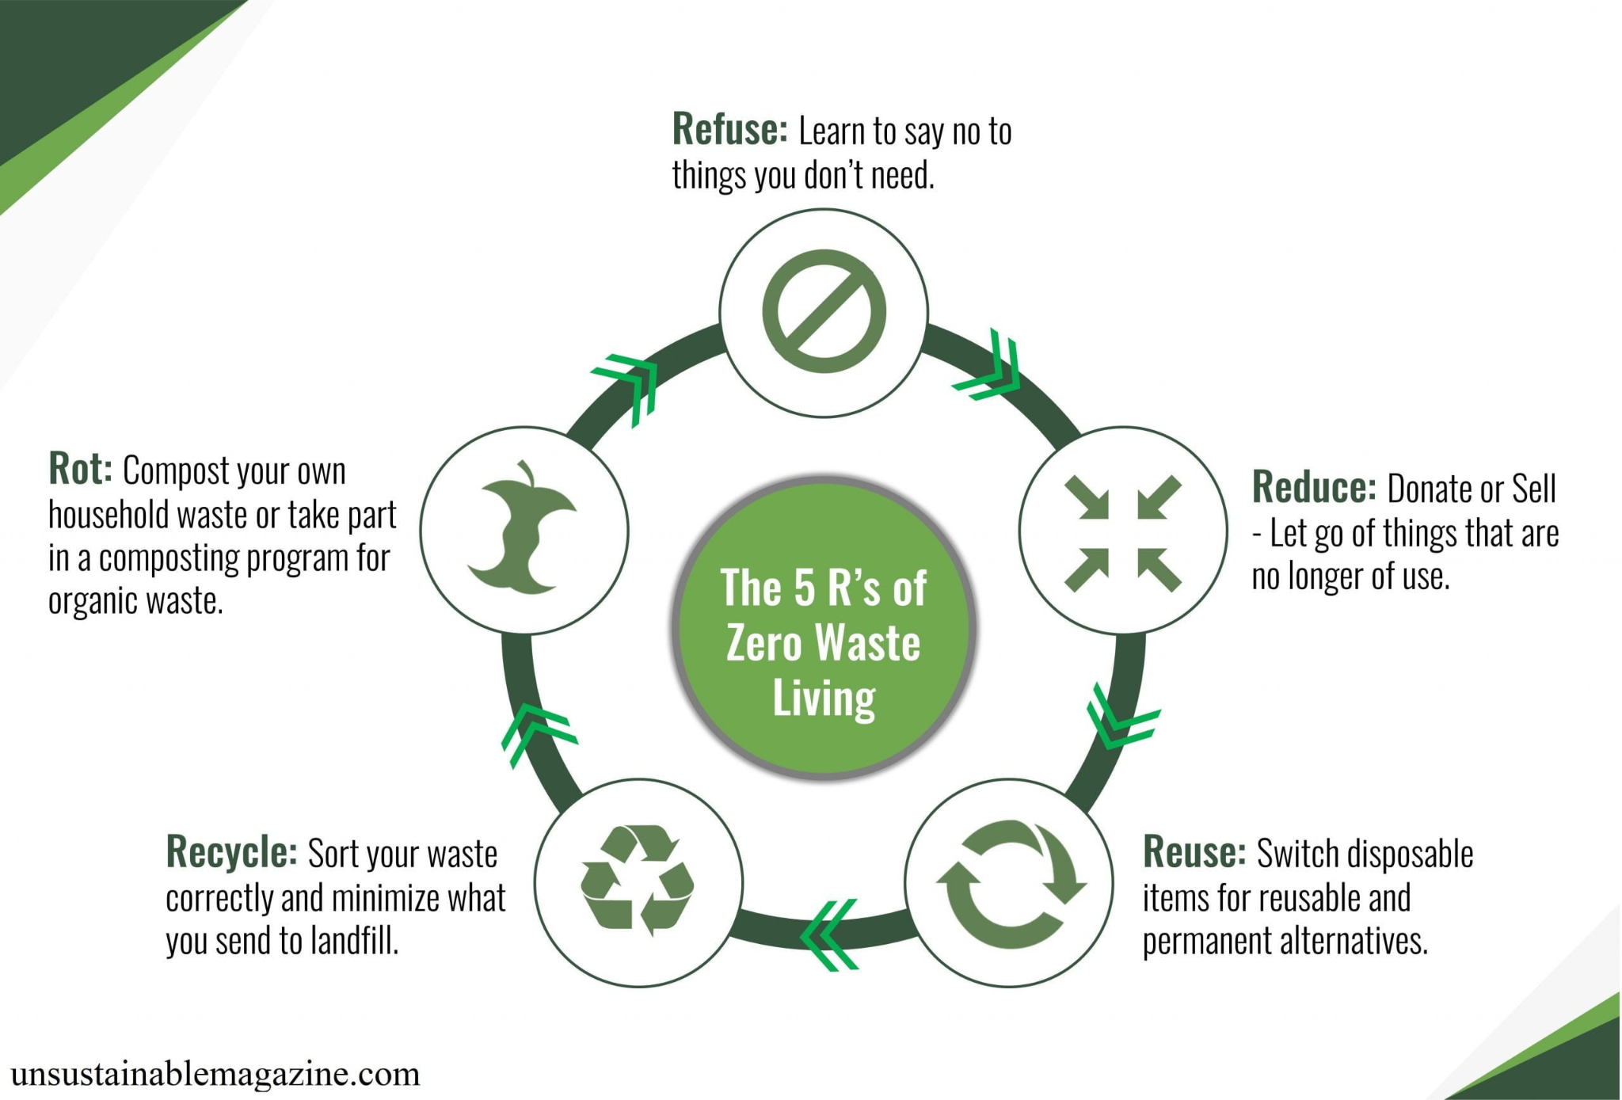

Slide 33
ENERGY & WATER CONSERVATION
Energy:
- Turn off lights and equipment
- LED lighting upgrade
- Natural ventilation
- Solar panel installation
- Energy monitoring
Savings: Environmental + Financial
Water:
- Fix leaks promptly
- Low-flow fixtures
- Rainwater harvesting
- Drought-resistant landscaping
- Water monitoring

Slide 34
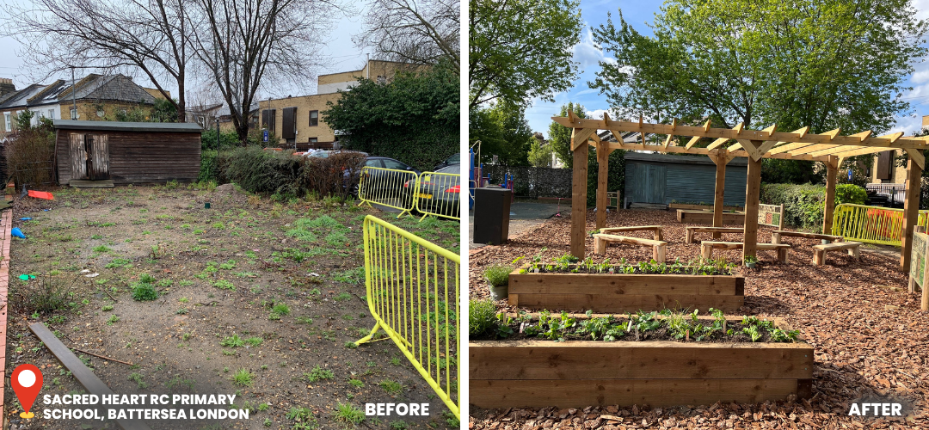
GREEN SCHOOL GROUNDS
Elements:
- School gardens (food, learning, biodiversity)
- Trees and native vegetation
- Outdoor classrooms
- Natural play areas
- Wildlife habitats
- Permeable surfaces & rain gardens
Benefits:
Learning | Health | Biodiversity | Climate | Community

Slide 35
SUSTAINABLE PROCUREMENT
Green Purchasing Principles:
1. Reduce consumption overall
2. Choose sustainable products (recycled, renewable, non-toxic)
3. Support ethical businesses (fair labor, local, transparent)
4. Consider lifecycle costs
Product Categories:
Paper | Cleaning | Office Supplies | Electronics | Furniture | Food | Uniforms
Every purchase is a vote!

Slide 36
06
COMMUNITY ENGAGEMENT

Slide 37
COMMUNITY CONSULTATION
Why Consult?
- Address issues communities care about
- Tap into community knowledge and resources
- Ensure cultural relevance
- Build ownership and support
- Model democratic participation
Principles:
Early & Ongoing | Inclusive | Transparent | Respectful | Accessible | Actionable

Slide 38
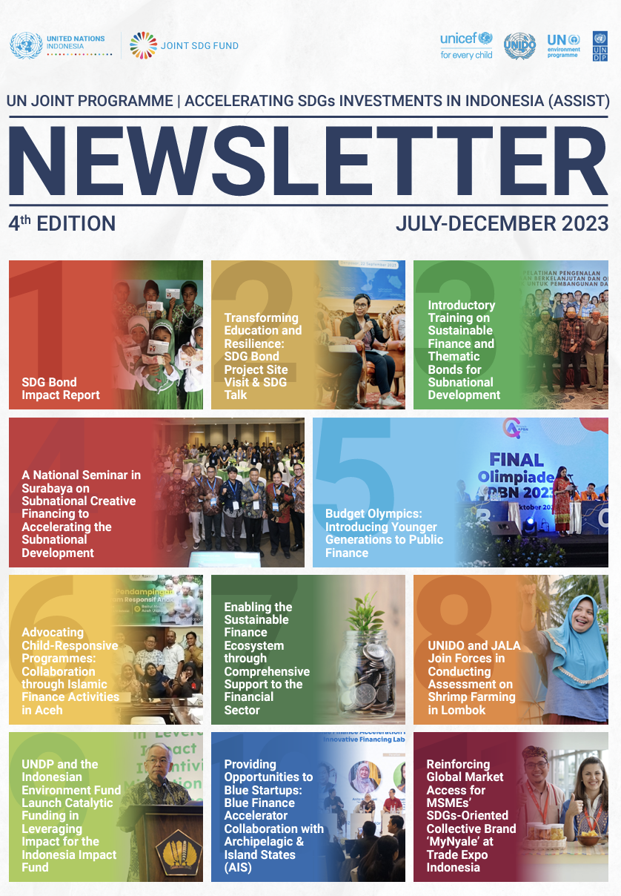
PARENT ENGAGEMENT STRATEGIES
Communication:
- Regular newsletters on SDG learning
- Social media updates
- Student-led sharing at home
Learning Together:
- Parent workshops on SDGs
- Family learning events
- Take-home activities

Slide 39

Involvement:
- Parent-Teacher SDG Committee
- Volunteer opportunities
- Home-school challenges
Engaging in Student Learning:
- Family projects
- Exhibition nights
- Portfolio conferences

Slide 40
07
CORPORATE PARTNERSHIPS

Slide 41
THE 5 MILE RADIUS PROJECT
Concept:
Companies adopt schools within 5-mile radius of operations, providing financial and technical support aligned with ESG commitments
Benefits for Companies:
- Fulfill ESG commitments with measurable impact
- Develop workforce pipeline
- Enhance reputation
- Employee engagement
Benefits for Schools:
- Infrastructure improvements
- Program funding
- Mentorship for students
- Access to expertise

Slide 42
PARTNERSHIP TIERS
Tier 1: Foundation Partner ($100,000-$200,000/year)
- Comprehensive school transformation
- 3-5 year commitment
- Governance participation
- Employee programs
1
Tier 2: Program Partner ($50,000-$99,999/year)
- Specific program support (STEM, arts, sustainability)
- 2-3 year commitment
- Quarterly engagement.
2
3
Tier 3: Project Partner ($20,000-$49,999/year)
- Specific SDG projects
- Annual renewable
- Volunteering opportunities
Target: 50 partnerships by 2028 = $15 million

Slide 43
PARTNERSHIP MANAGEMENT
National Commission Role:
- Match companies with schools
- Standard agreements and metrics
- Training for schools on corporate engagement
- Monitor effectiveness
- Showcase successes
- Annual partnership summit
Key Success Factors:
- Clear expectations and agreements
- Regular communication
- Measurable outcomes
- Recognition of contributions
- Mutual benefit

Slide 44
08
YOUTH LEADERSHIP

Slide 45
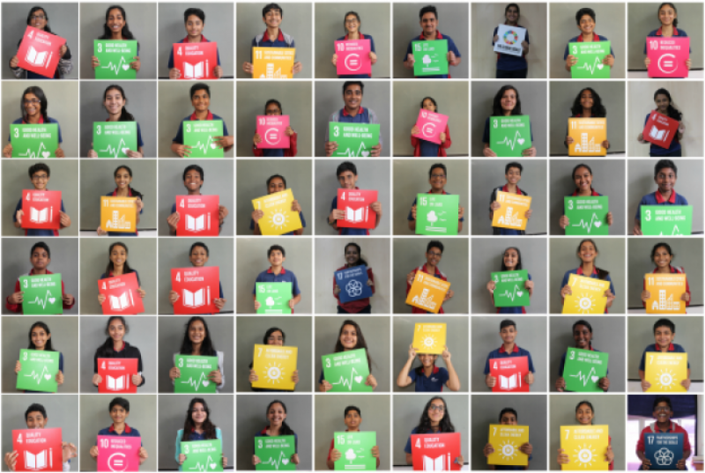
STUDENT SDG COUNCILS
Purpose:
Student voice and leadership in school SDG initiatives
Functions:
- Plan and implement SDG projects
- Lead awareness campaigns
- Monitor school sustainability
- Represent student perspectives
- Connect with other schools
- Participate in national events
Democracy in Action

Slide 46
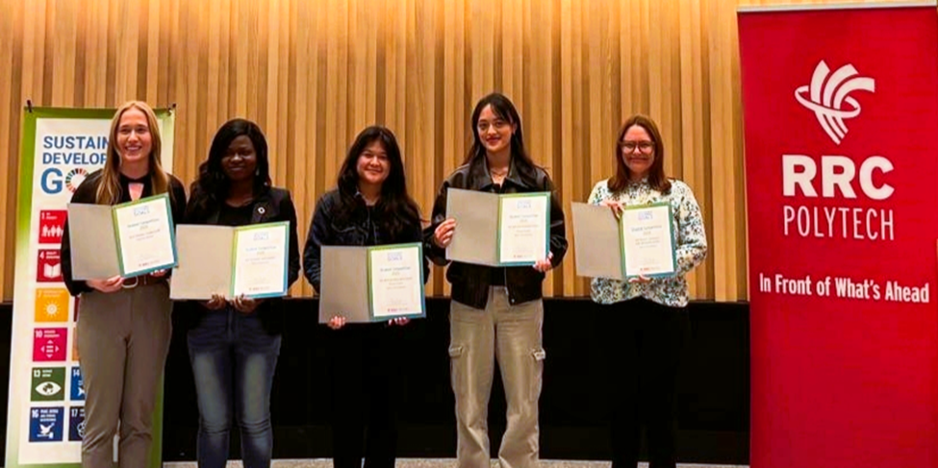
SDG CHAMPIONS PROGRAM
Program:
Training and certification program for youth SDG leaders
Components:
- 40-hour training (knowledge, skills, leadership)
- Action project requirement
- Peer education component
- Ongoing support network
- Formal certification
Target: 2,000 certified Champions by 2028
Outcomes:
- Youth equipped to lead change
- Multiplier effect (champions train others)
- Alumni network

Slide 47
09
MONITORING & EVALUATION

Slide 48
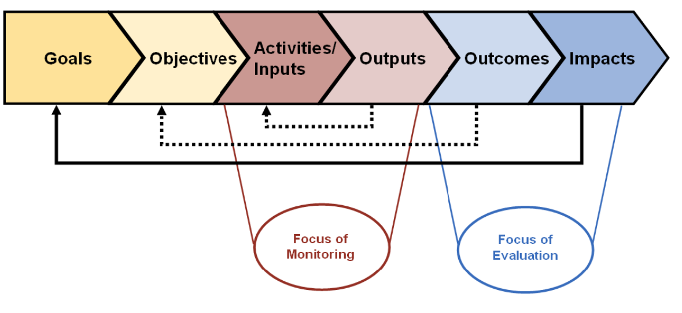
M&E FRAMEWORK
Purpose:
- Track progress toward objectives
- Assess effectiveness
- Document lessons learned
- Ensure accountability
- Enable continuous improvement
Evaluation Schedule:
- Baseline (Q1 2026)
- Quarterly progress reviews
- Annual evaluations
- Mid-term evaluation (Q3 2027)
- Final impact assessment (Q3 2028)

Slide 49
KEY PERFORMANCE INDICATORS (KPIs)
Education Integration:
- ASPnet schools operational (Target: 200)
- Teachers trained (Target: 6,000)
- SDG curriculum integration (Target: 100%)
Awareness & Engagement:
- National awareness (Target: 80%)
- Media reach and sentiment
- Event participation
Partnerships:
- Corporate partnerships (Target: 50)
- Investment mobilized (Target: $15M)
- Community partnerships (Target: 300)
Youth Leadership:
- SDG Champions (Target: 2,000)
- Social enterprises (Target: 50)

Slide 50
THANK YOU

