Slide 1



Implementing a Whole School Approach to Teaching the Sustainable Development Goals (SDGs)
St. Joseph’s Convent San Fernando
- Aspnet Secondary School

Slide 2


Slide 3


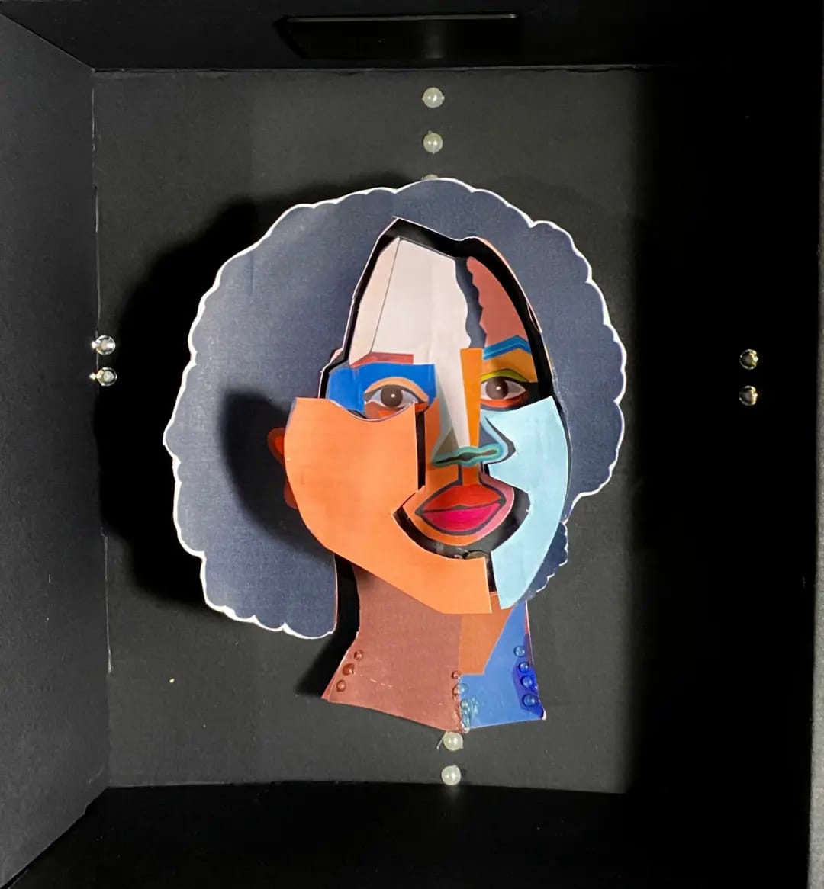
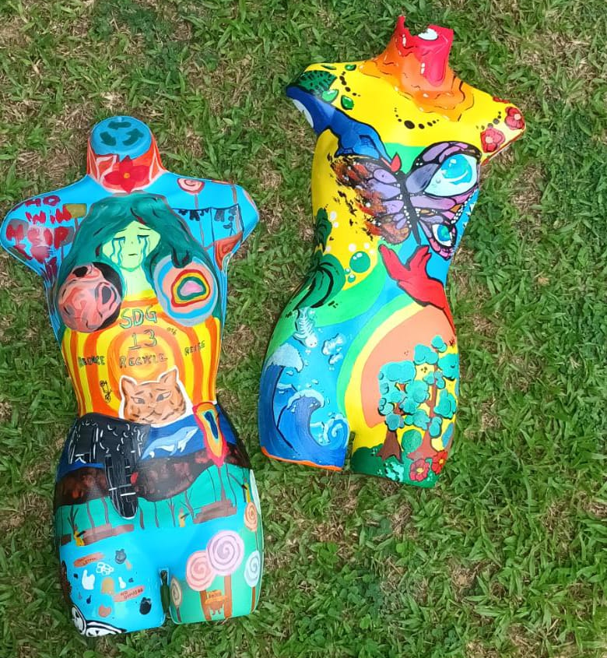

Slide 4

Introduction: St. Joseph’s Convent
San Fernando’s Unique Approach
Abstract:
This report discusses the innovative approach adopted by St. Joseph’s Convent San Fernando in the Caribbean in teaching the Sustainable Development Goals (SDGs). The school has embraced a comprehensive, whole school approach, which encompasses curriculum, capacity-building, community engagement, collaboration, and inclusivity. The report highlights the benefits of this approach, utilizes diagrams for clarity, and provides insights into how it is effectively executed.
St. Joseph’s Convent San Fernando, an ASPnet school in the Caribbean, has established itself as a trailblazer in the field of SDG education. The school has adopted a holistic “whole school approach” that permeates all aspects of its operations, ensuring that the SDGs are not just taught but also lived.

Slide 5
Benefits of the Whole School Approach
The whole school approach has numerous advantages:
a. Comprehensive Learning:
Curricular Integration: The SDGs are seamlessly integrated into the school’s curriculum, spanning all subjects and age groups.
Lifelong Learning: Students gain a deep understanding of the SDGs and develop a lifelong commitment to sustainable development.
b. Capacity-Building:
Teacher Training: Faculty members are provided with continuous professional development to effectively teach the SDGs.
Student Empowerment: Students are equipped with critical thinking and problem-solving skills to address global challenges.
c. Community Engagement:
Partnerships: The school collaborates with local organizations, experts, and NGOs to engage the community in SDG initiatives.
Awareness: The wider community is educated about the SDGs, creating a collective sense of responsibility.
d. Collaboration:
Interdisciplinary Projects: Students work on cross-curricular projects, promoting teamwork and problem-solving.
Peer Learning: Collaboration fosters peer-to-peer learning, enhancing understanding and empathy.
e. Inclusivity:
Diverse Perspectives: The whole school approach promotes inclusivity, considering the diverse cultural, social, and economic backgrounds of students.
Equity: Special efforts are made to ensure that no student is left behind, regardless of their individual circumstances.

Slide 6
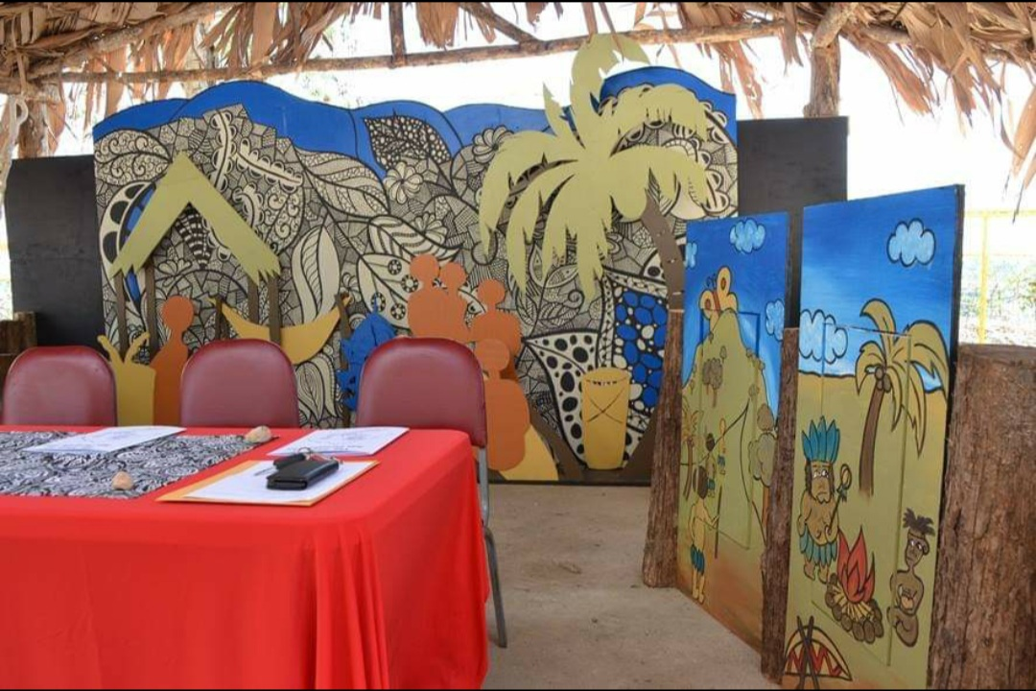
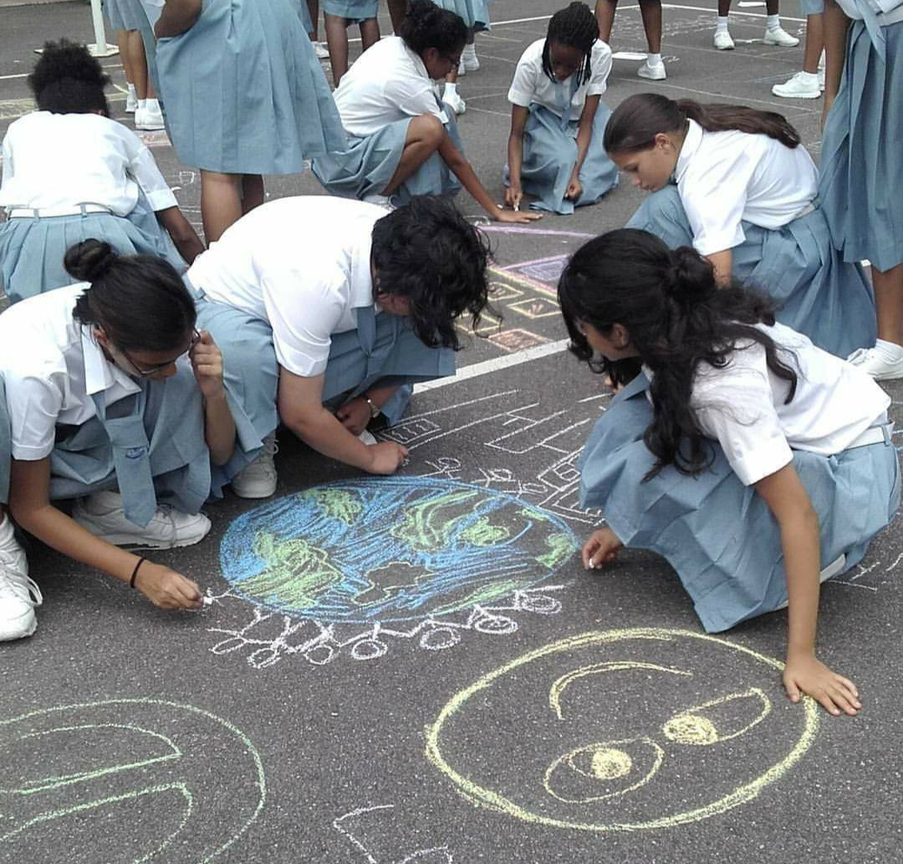
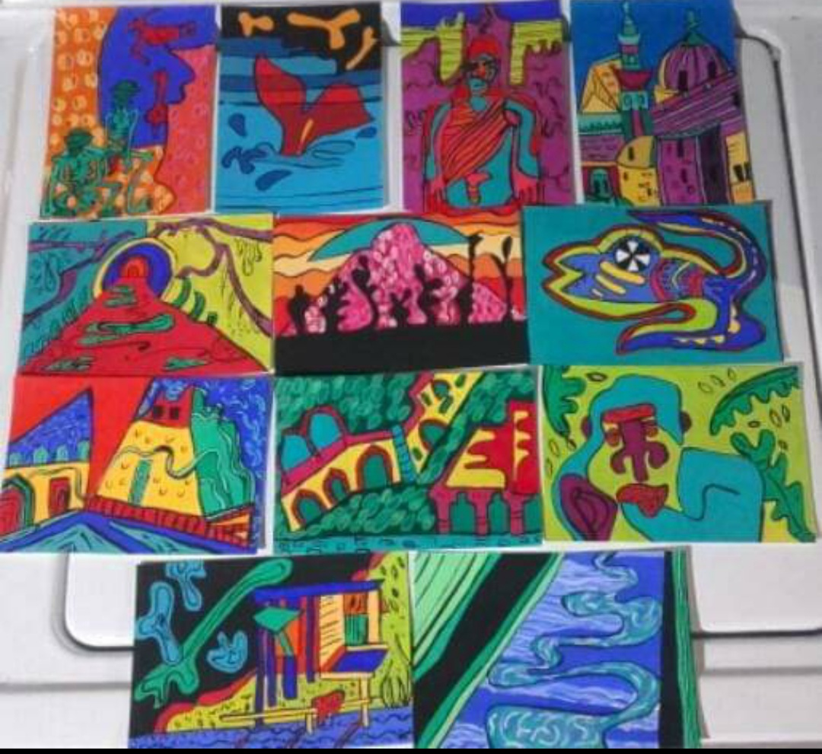

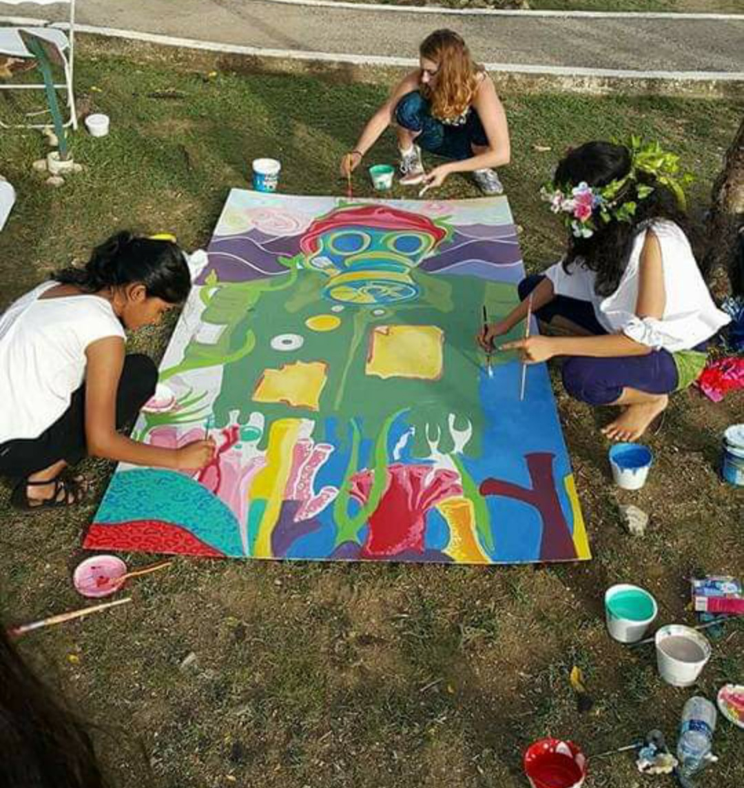


Slide 7

Diagrams Illustrating the Whole School Approach
a. Curriculum Integration:
Diagram 1:
A curriculum with the SDGs at the core, showing how various subjects revolve around them.
b. Capacity-Building:
Diagram 2:
A flowchart illustrating the continuous professional development process for teachers.
c. Community Engagement:
Diagram 3: A network diagram representing the school's partnerships with local organizations and experts.
d. Collaboration:
Diagram 4: A Venn diagram showcasing the intersection of subjects in cross-curricular projects.
e. Inclusivity:
Diagram 5: An infographic displaying the school's strategies for promoting inclusivity and equity.

Slide 8
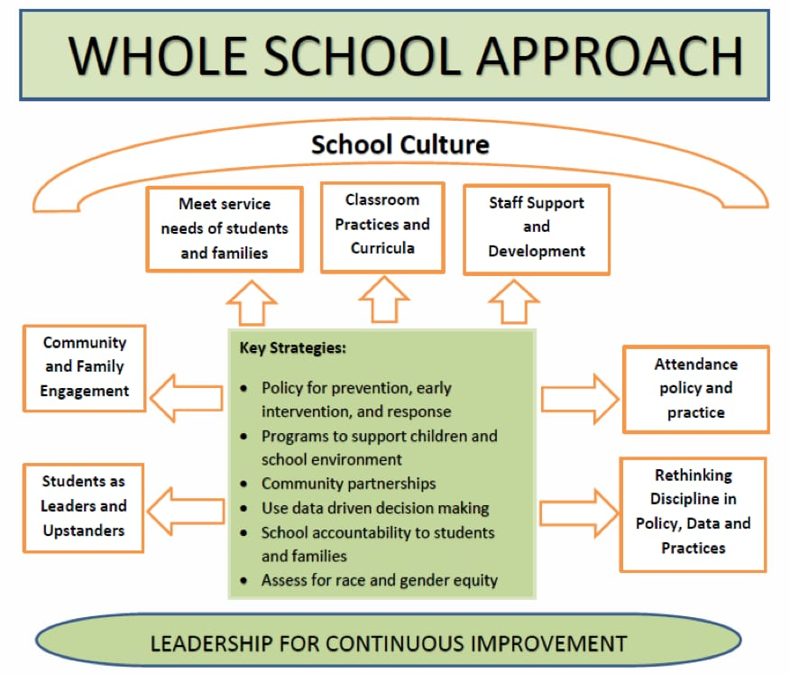


Slide 9





Slide 10
Execution of the Whole School Approach:
The whole school approach is executed through several key strategies:
a. Curriculum Development:
Creation of SDG-focused curricular materials for all grade levels.
Regular review and updates to ensure relevance.
b. Professional Development:
Workshops, seminars, and mentoring programs for faculty.
Encouragement of self-directed learning.
c. Community Outreach:
Hosting awareness events, workshops, and SDG-related community service projects.
Involvement in regional and international SDG conferences.
d. Interdisciplinary Projects:
Identification of common themes that can be explored across subjects.
Cross-departmental coordination for project design and implementation.
e. Inclusivity Programs:
Scholarship and financial aid programs to ensure access for all.
Support systems for students with diverse learning needs.

Slide 11
Conclusion:
St. Joseph's Convent San Fernando's whole school approach to teaching the SDGs is a pioneering effort that sets an example for educational institutions worldwide. The benefits of this approach, combined with effective execution, ensure that students not only learn about the SDGs but also become active agents of change, contributing to a more sustainable future. Attached are a series of images across the years showing integration through the arts and systems that were put into place to execute the whole school approach.

