Slide 1
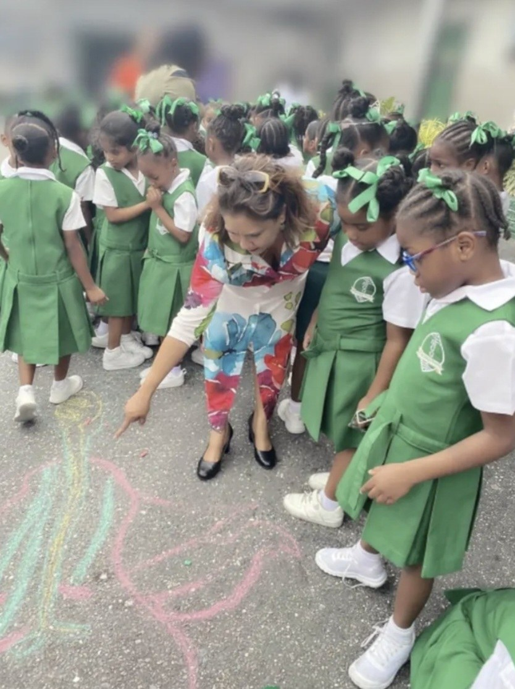

UNESCO ASPnet Club
Big Sisters
Programme
In Collaboration with St Gabriel's
📚 Literacy
🔢 Maths
🔬 STEAM
🌍 Climate
🇪🇸 Friday: Introduction to Spanish — Languages Club
Community Service · SDG Projects · Peer Mentorship
Commencing Next Term | March 2026

Slide 2
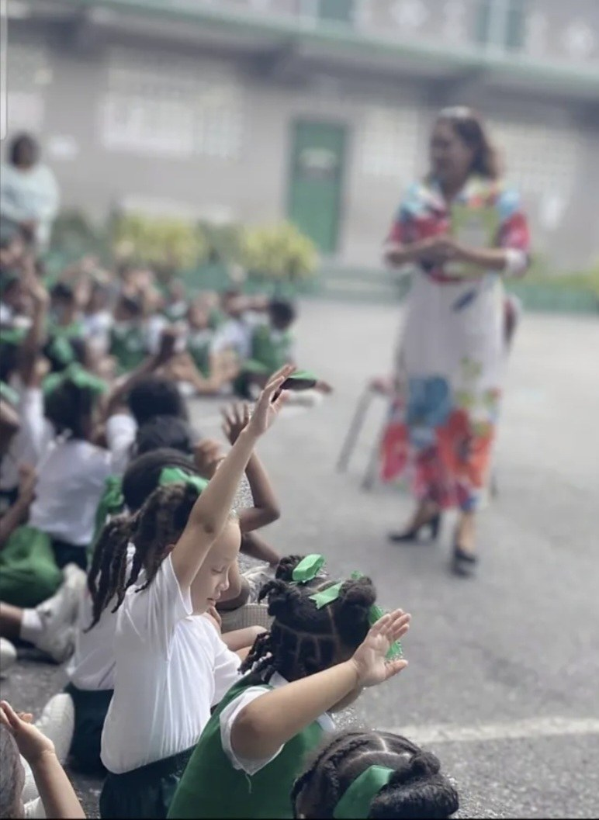



What is the Big Sisters Programme?
4
4
1hr
SDG Theme
Groups
Students
Per Group
Per Session
After School
A structured inter-school mentorship & community service initiative where senior UNESCO Club members guide younger students through SDG-aligned learning experiences.
Community Service
Peer Mentorship
Global Citizenship
Earn hours through
SDG project delivery
Big Sisters guide
Little Sisters
Live the SDGs through
real projects
UNESCO ASPnet Club | Big Sisters Programme | In Collaboration with St Gabriel's

Slide 3




The Five Weekly Sessions
Four SDG theme groups run Monday–Thursday, with a special Friday Languages session
MONDAY
TUESDAY
WEDNESDAY
THURSDAY
📚
🔢
🔬
🌍
Literacy
Magical Maths
STEAM – Design & Innovation
Climate & Disaster Risk
SDG 4 — Quality Education
SDG 4 & 10 — Education & Equality
SDG 9 — Industry & Innovation
SDG 13 — Climate Action
4 students · 1 hour
4 students · 1 hour
4 students · 1 hour
4 students · 1 hour
🇪🇸 FRIDAY — Introduction to Spanish | Languages Club
Cultural & linguistic enrichment for all students

Slide 4

Monday: Literacy
SDG 4 — Quality Education
What students will experience:
Structured reading & comprehension sessions
Storytelling, phonics, and vocabulary building
Materials and lesson plans provided by coordinator
Teacher present to support and observe
Tailored to primary school literacy levels
📚
DAY
Monday
STUDENTS
4 per group
DURATION
1 Hour
A dedicated St Gabriel's teacher is assigned to every session for support and safeguarding.
UNESCO ASPnet Club | Big Sisters Programme | In Collaboration with St Gabriel's

Slide 5
Tuesday: Magical Maths
SDG 4 & 10 — Education & Equality
What students will experience:
Hands-on numeracy and problem-solving activities
Games, puzzles, and real-world maths applications
Big Sisters guide students step by step
Builds confidence and a love of numbers
Aligned to SDG 4 — Quality Education
🔢
DAY
Tuesday
STUDENTS
4 per group
DURATION
1 Hour
A dedicated St Gabriel's teacher is assigned to every session for support and safeguarding.
UNESCO ASPnet Club | Big Sisters Programme | In Collaboration with St Gabriel's

Slide 6
Wednesday: STEAM – Design & Innovation
SDG 9 — Industry & Innovation
What students will experience:
Design & Innovation using Lego and craft materials
Engineering challenges and creative problem-solving
Students design, build, test, and reflect
Big Sisters facilitate the design thinking process
Aligned to SDG 9 — Innovation & Infrastructure
🔬
DAY
Wednesday
STUDENTS
4 per group
DURATION
1 Hour
A dedicated St Gabriel's teacher is assigned to every session for support and safeguarding.
UNESCO ASPnet Club | Big Sisters Programme | In Collaboration with St Gabriel's

Slide 7
Thursday: Climate & Disaster Risk
SDG 13 — Climate Action
What students will experience:
Climate change awareness and disaster preparedness
Hands-on environmental projects and experiments
Understanding local and global climate impact
Linking classroom learning to real-world action
Aligned to SDG 13 — Climate Action
🌍
DAY
Thursday
STUDENTS
4 per group
DURATION
1 Hour
A dedicated St Gabriel's teacher is assigned to every session for support and safeguarding.
UNESCO ASPnet Club | Big Sisters Programme | In Collaboration with St Gabriel's

Slide 8
Friday: Introduction to Spanish — Languages Club
🇪🇸
What the Friday session includes:
Fun, interactive introduction to the Spanish language
Greetings, numbers, colours, and everyday vocabulary
Cultural exploration — Spanish-speaking countries and traditions
Songs, games, and conversational practice activities
Delivered by the Languages Club — broadening global awareness
DAY
Friday
LED BY
Languages Club
CONTENT
Intro Spanish
¡Hola! The Languages Club adds a cultural & linguistic dimension every Friday for all students.
UNESCO ASPnet Club | Big Sisters Programme | In Collaboration with St Gabriel's

Slide 9



How Each Session Works
Every session follows a consistent, structured 1-hour format
45 min
10 min
5 min
SDG Lesson
Recap
Clean Up
Big Sisters deliver the
provided lesson plan.
Teacher supports throughout.
Big Sisters review key
takeaways with students.
Reinforces learning.
Pack away materials,
tidy the room, and prepare
for departure.
Total: 1 Hour After School · Supervised by an assigned St Gabriel's teacher throughout

Slide 10


Who Benefits — and How?
Big Sisters
Little Sisters
UNESCO Club Members
St Gabriel's Students
Earn community service hours
Near-peer role models to look up to
Build leadership & teaching skills
Enriched after-school activities
Deepen SDG knowledge
Safe & supervised environment
Professional mentorship experience
Literacy, Maths, STEAM & Climate skills
Rotate across all 4 themes per year
Friday Spanish language exposure
UNESCO ASPnet Club | Big Sisters Programme | In Collaboration with St Gabriel's

Slide 11


Supporting Students Who Stay After School
Instead of waiting in an unstructured environment, after-school students will:
Engage in a 45-min structured SDG lesson tailored to their level
Feel included, supported, and excited — not just waiting
Be supervised by trained Big Sisters and a school teacher
Enjoy a consistent daily schedule — something to look forward to
Build friendships and connections across year groups
UNESCO ASPnet Club | Big Sisters Programme | In Collaboration with St Gabriel's

Slide 12

Roles & Responsibilities
Club Executives
Big Sisters
Coordinate group sign-up (4 per group)
Submit lists to coordinator
Distribute consent letters
Manage term rotations
Attend all assigned sessions
Deliver provided lesson plans
Facilitate 10-min recap
Support clean-up at end
School Teacher
Coordinator
Assigned to each thematic group
Classroom management support
Safeguarding oversight
School-club liaison
Provide lesson plans & materials
Oversee SDG alignment
Certify service hours
Monitor programme quality
UNESCO ASPnet Club | Big Sisters Programme | In Collaboration with St Gabriel's

Slide 13
Community Service Hours
How hours are logged:
1
session
=
1 community
service hour
Attendance recorded each session
Maintained by Programme Coordinator
Certified and signed off each term
All UNESCO Club members eligible
Rotation across themes every term
📋 Parental consent letters will be distributed before the programme launches. No member participates without a signed form.
UNESCO ASPnet Club | Big Sisters Programme | In Collaboration with St Gabriel's

Slide 14
Let's Build the Future Together
The Big Sisters Programme — mentorship, service, and global citizenship in action
Club Executives
All Members
Coming Soon
Collect group sign-ups
this week
Confirm your preferred
theme group
Parent consent letters
to be distributed
UNESCO ASPnet Club | Big Sisters Programme | In Collaboration with St Gabriel's | March 2026

